Slide 1
Studying the Psalms
“Psalms of Praise”
Psalms 65 (continued)
March 27, 2022

Slide 2
Psalms 65
Praise And Thanksgiving For God’s Abundant Favor To Earth And Man
God’s power at work on behalf of His people. Verses 5-8
Psalms 65:5, “By terrible things thou wilt answer us in righteousness, Oh God of our salvation, Thou that art the confidence of all the ends of the earth, and of them that are afar off upon the sea”
NOTE: God will hear His people’s prayers (verse 2) and answer them (Isaiah 65:24; cf. Matthew 7:7-8;
1 John 5:14-15) in righteousness (Psalms 103:6;
Zephaniah 3:5). See also, 1 Peter 3:12
All men can trust God (confidence) just as the seaman.
cf. Psalms 107:23-30.

Slide 3
Psalms 65
Praise And Thanksgiving For God’s Abundant Favor To Earth And Man
God’s power at work on behalf of His people.
Verses 5-8
Psalms 65:6-7, “Who by his strength setteth fast the mountains, being girded about with might; Who stilleth the roaring of the seas, the roaring of their waves, and the tumult of the peoples.”
See Psalms 93:1, 3-4
His great power is visible to all. Romans 1:20;
cf. Acts 14:16-17; Acts 17:26-28
Note: Mark 4:39. cf. Psalms 107:29; Isaiah 17:12-13

Slide 4
‘Til the Storm Passes By
Gaither Vocal Band
In the dark of the midnight have I oft hid my face
While the storm howls above me, and there's no hiding place
'Mid the crash of the thunder, Precious Lord, hear my cry
Keep me safe till the storm passes by
Till the storm passes over, till the thunder sounds no more
Till the clouds roll forever from the sky
Hold me fast, let me stand in the hollow of Thy hand
Keep me safe till the storm passes by
Many times Satan whispered
There is no use to try
For there's no end of sorrow, there's no hope by and by
But I know Thou art with me, and tomorrow I'll rise
Where the storms never darken the skies
Till the storm passes over, till the thunder sounds no more
Till the clouds roll forever from the sky
Hold me fast, let me stand in the hollow of Thy hand
Keep me safe till the storm passes by
Source: Musixmatch
Songwriters: Thomas Mosie Lister

Slide 5
Psalms 65
Praise And Thanksgiving For God’s Abundant Favor To Earth And Man
God’s power at work on behalf of His people.
Verses 5-8
Psalms 65:8, “They also that dwell in the uttermost parts are afraid at thy tokens: Thou makest the outgoings of the morning and evening to rejoice.”
Somewhat a repeat of verse 5. The manifest tokens (signs) of God make all to tremble and rejoice at His power. (cf. Psalms 66:5-6; 89:12; 98:4).

Slide 6
Psalms 65
Praise And Thanksgiving For God’s Abundant Favor To Earth And Man
God’s provisions for His people. Verses 9-13
Psalms 65:9, “Thou visitest the earth, and waterest it, Thou greatly enrichest it; the river of God is full of water: Thou providest them grain, when thou hast so prepared the earth.”
God in His great wisdom attends to all the needs of the earth; surveys the condition of things; arranges for the welfare of the world which He has made; and supplies the needs of those whom He has created to dwell upon it. Acts 14:15-17; cf. Ezekiel 34:26-27 … Evidence that HE is God!

Slide 7
Psalms 65
Praise And Thanksgiving For God’s Abundant Favor To Earth And Man
God’s provisions for His people. Verses 9-13
Psalms 65:10, “Thou waterest its furrows abundantly; Thou settlest the ridges thereof: Thou makest it soft with showers; Thou blessest the springing thereof.”
As God supplies abundant rain to supply our needs, He likewise supplies our spiritual needs in abundance.
Isaiah 55:10-11, “For as the rain cometh down and the snow from heaven, and returneth not thither, but watereth the earth, and maketh it bring forth and bud, and giveth seed to the sower and bread to the eater; so shall my word be that goeth forth out of my mouth: it shall not return unto me void, but it shall accomplish that which I please, and it shall prosper in the thing whereto I sent it.” (Isaiah 55:7; John 10:10)

Slide 8
Psalms 65
Praise And Thanksgiving For God’s Abundant Favor To Earth And Man
God’s provisions for His people. Verses 9-13
Psalms 65:11, “Thou crownest the year with thy goodness; and thy paths drop fatness.”
The fact that he “sendeth rain on the just and the unjust” is evidence of God’s love for even those who hate Him (Matthew 5:44-45; cf. Luke 6:35).

Slide 9
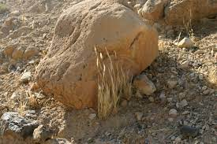

Psalms 65
Praise And Thanksgiving For God’s Abundant Favor To Earth And Man
God’s provisions for His people. Verses 9-13
Psalms 65:12, “They drop upon the pastures of the wilderness; and the hills are girded with joy.” cf. Psalms 23

Slide 10
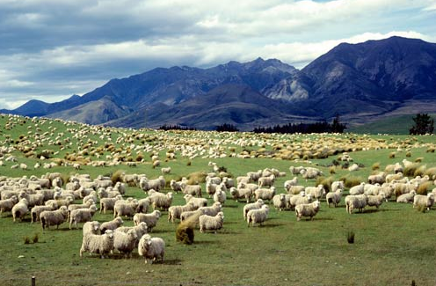
Psalms 65
Praise And Thanksgiving For God’s Abundant Favor To Earth And Man
God’s provisions for His people. Verses 9-13
Psalms 65:13, “The pastures are clothed with flocks; the valleys also are covered over with grain; they shout for joy, they also sing.”
The pastures of the wilderness were the places where flocks
grazed (Luke 15:4;
1 Samuel 25:1-4) – so, when God watered the pastures
abundantly (verses 9-11), the pastures would become clothed with flocks.

Slide 11
Psalms 65
Praise And Thanksgiving For God’s Abundant Favor To Earth And Man
God’s provisions for His people. Verses 9-13
Physical application to Israel in the restoration.
Isaiah 44:23ff
Now make the spiritual application:
  Let us remember, it is God’s goodness (not man’s) which provides mercy and forgiveness. “But God commendeth his own love toward us, in that, while we were yet sinners, Christ died for us” (Romans 5:8). Why would anyone despise such goodness?!

